Slide 1
DATA PRESENTATION AND ANALYSIS
LECTURE BY LUCY GATERI

Slide 2
Data Presentation: is the way in which data is displayed for viewing, interpreting & understanding
methods of data presentation
Tables
Charts
Graphs
Frequency distribution tables
Histograms
Narrative method

Slide 3
Qualitative Data Presentation and Analysis
The data presentation and analysis of qualitative research is quite different from that of presenting data collected when using the quantitative research method
This is because qualitative research uses words while quantitative uses numbers (numerical).
However, the principles are the same for both types. In both cases the researcher has to do the following:
a) Describe the sample population by providing a description of the:
Respondents, for instance, key informants or focus group members.
Age, sex, occupation, educational background etc.
b) Order, reduce and/or code the data (data processing).
c) Display the summaries of data for interpretation.
d) Draw conclusions.
e) Develop strategies for testing or confirming the findings to prove their validity.

Slide 4
Measures of Central Tendency
Referred to as 'average' measures. They describe how closely related the data is.
1. Mode: it is the numerical value or score that occurs most times. It is the most suitable measure of central tendency for nominal data.
2. Median: it is the score at the exact centre of a distribution; it is also called the 50th percentile. It is the most central value when raw data is arranged on a scale from the highest to the lowest.
3. Mean: It is the total sum of scores divided by the number of scores being summed. The mean is the most suitable measure of central tendency for interval and ratio level data.

Slide 5
Measures of Dispersion
Are used to measure the individual differences of scores in a sample. They give an indication of how scores in a sample are dispersed around the mean.
They show how different the scores are or the extents to which individual scores deviate from one another.
If the individual scores are similar, the measure of variability is small and the sample is relatively similar or homogeneous in terms of those scores. A wide variation in scores may indicate a heterogeneous sample.
1. Range: It is obtained by subtracting the lowest score from the highest score. The range is the difference between the highest and lowest score. It is not a very significant statistical measure.

Slide 6
2. Variance: it is a measure of how individual scores in a set of data vary in their distribution from one to the other.
3. Standard Deviation: It is calculated by finding the square root of variance - that means you have to calculate the variance first.
MEASUREMENT SCALES
Nominal scale: the lowest level of measurement. It groups subjects or cases from the sample into categories. Variables which can only be measured at the nominal scale include: sex, race, marital status, color etc
Ordinal scale: it not only groups subjects into categories, but it also ranks them into some order, this could be in an increasing order. i.e., in an ordinal scale, numerals are used to represent relative position or order among the values of the variables. E.g.; social class, military rank etc.

Slide 7
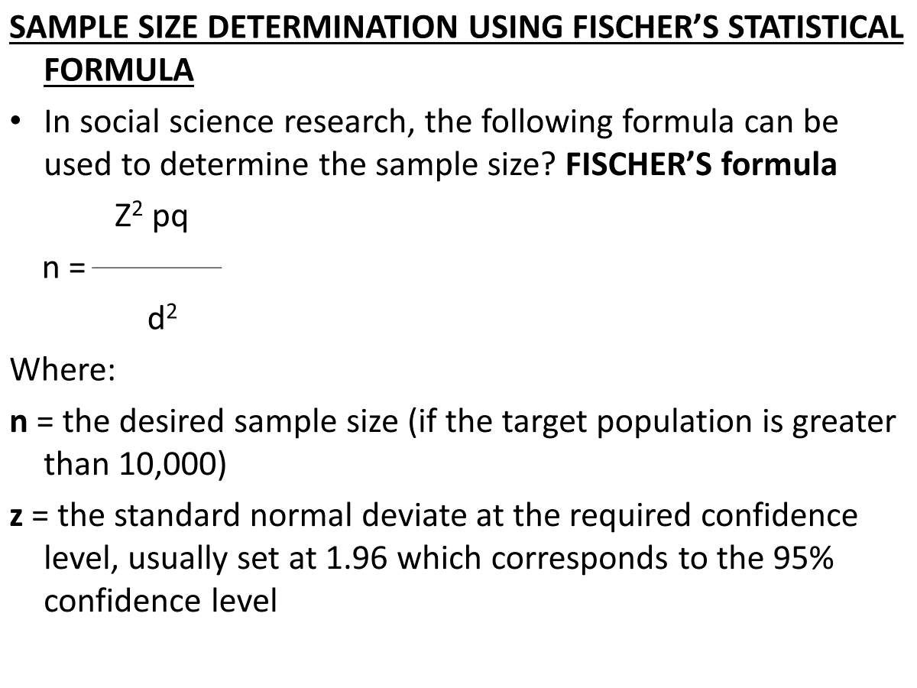

Slide 8
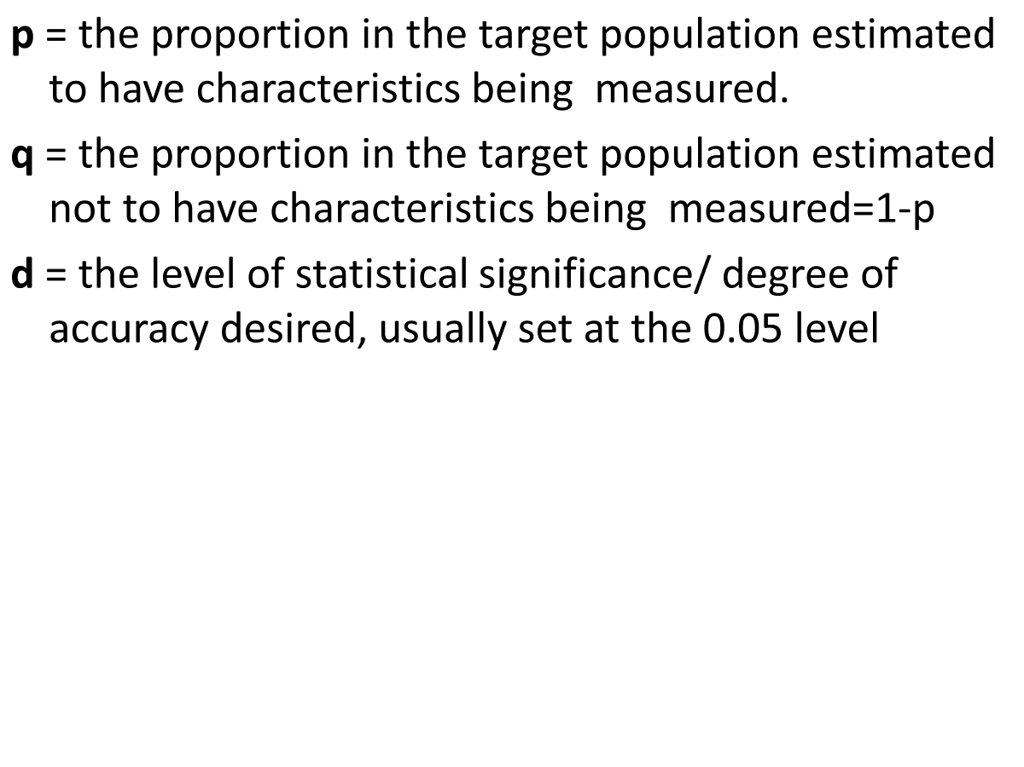
ctn

Slide 9
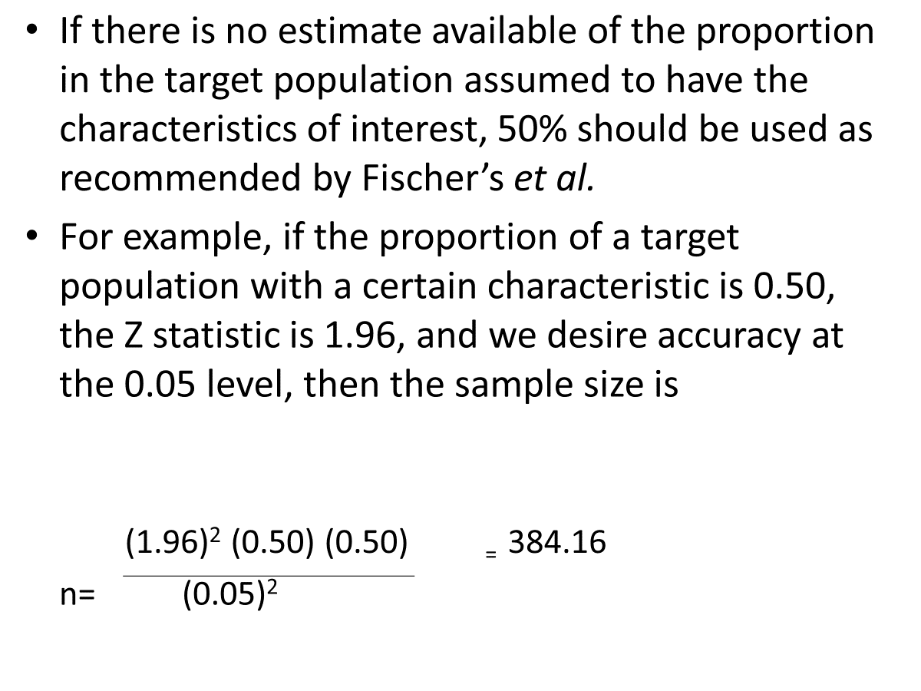
ctn

Slide 10
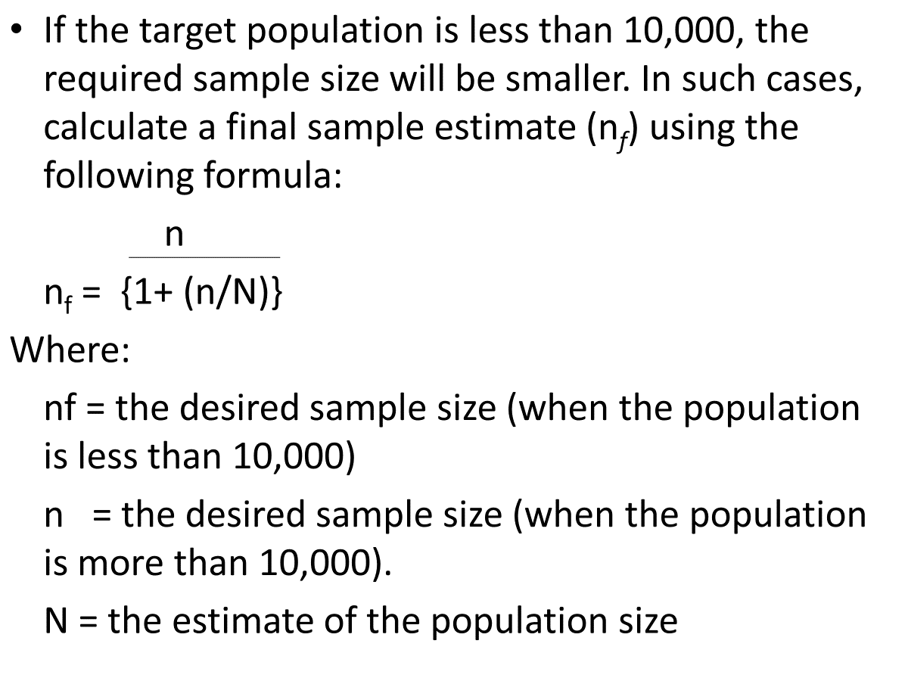
ctn

Slide 11
End
Thank you

